Slide 1
Rick's Self-Introduction

Slide 2
Outline
Projects Introduction
台灣歌爾：SmartMic with VAD+KWD
威剛-隆宸星：Wahoo Chatbot Engine
Personal Researches
Speech Enhancement
Speech Separation

Slide 3
SmartMic
緣起
語音助理無所不在； 手機、汽車、消費性電子產品、家電等。
目的
喚醒詞在麥克風端偵測，能低延遲和低功耗。
功能
VAD
KWS

Slide 4
VAD及KWS開發簡介
1. 以深度學習技行建構語音功能模型，並執行資源極限制的邊緣環境。
2. 研發離線低功耗、低資源具喚醒詞麥克風智能晶片。
3. 希望以此為基礎，未來研發具備離線命令詞的麥克風智能晶片。

Slide 5
VAD及KWS開發簡介
1. Deep Learning Framework: Tensorflow and Pytorch
2. Deep Learning Model Architectures: VAD: Two-Layer Full Connected Neural Network. KWS: Three-Layer Full Connected Neural Network.
3. Training Speech Corpus: Keyword-spotting research datasets.
4. Compression Approach: Int8 Quantization.

Slide 6
專案成果
VAD： 1. 已完成。
2. 準確率：93%-96%。
3. 模型大小：10K。
KWS:
1. Float and Int8 KWS Model。
2. 準確率：85-95%。
3. 模型大小：36K。。

Slide 7
威剛-隆宸星：Wahoo Chatbot Engine
實現語音句字命令，連接在地服務，包含控制家中家電。
更人性化對話。
提供外接第三方NLP Engine。
最適回應語句計算及輸出。

Slide 8
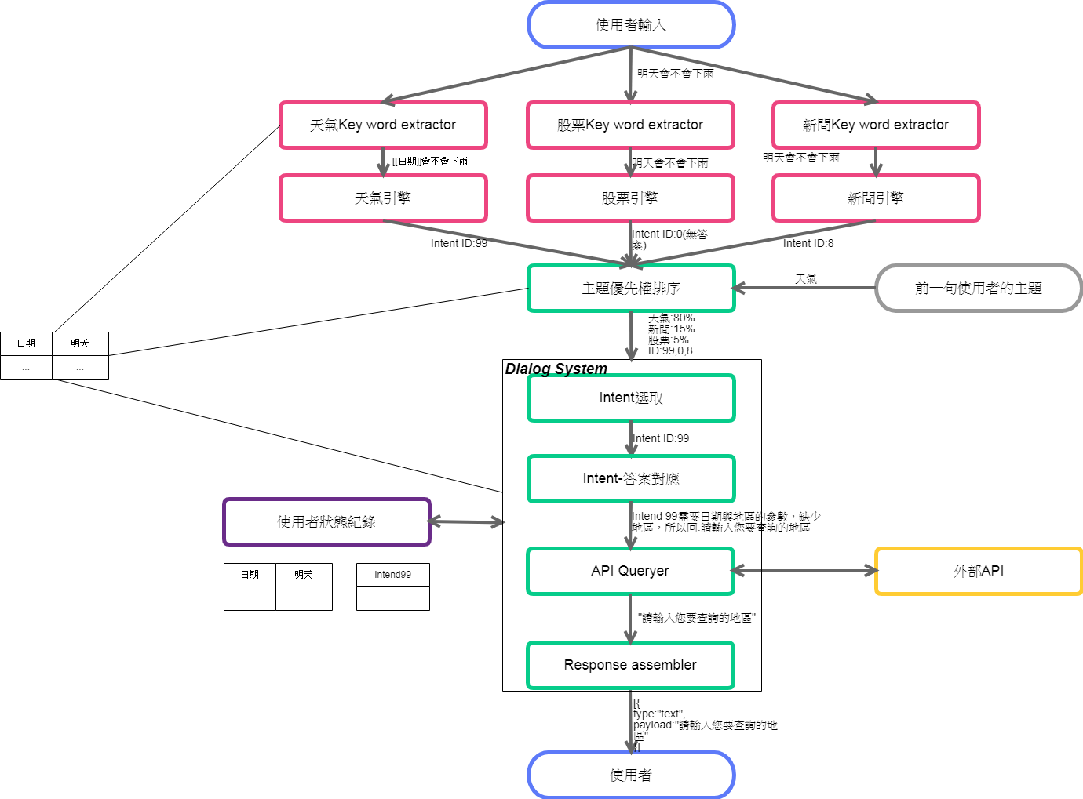
Wahoo Engine Architecture

Slide 9
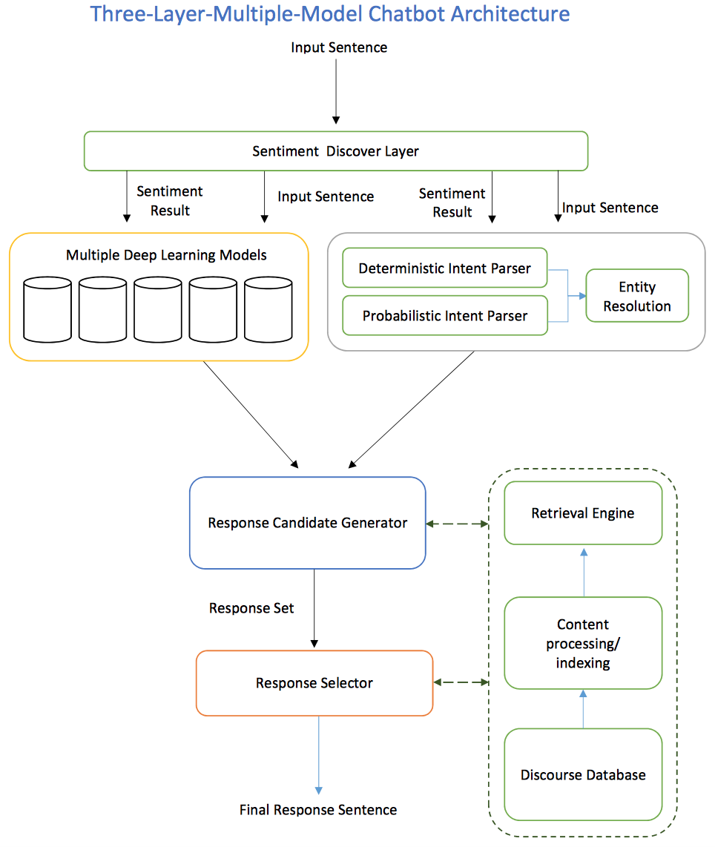
Wahoo Engine Architecture

Slide 10
Rule-based + AI
將對話當時環境因素加入考量，增強對話更擬人化。
提升語句命令中關鍵詞補捉的容錯率。
個人化體驗。
結合知識圖譜，提供具建議性特質的回應。

Slide 11
後語：
Wahoo Chatbot Engine幾年前開放源碼，目的希望結合大家的力量，將這套引擎發展得更好：
網址：https://github.com/xrick/Wahoo/

Slide 12
個人研究
Deep-Learning Based Speech Enhancement. (Dr.)
Deep-Learning Based Speech Separation. (Dr.)
Deep-Learning Model Quantization.(Personal)

Slide 13
Speech Separation and Speech Enhancement
Speech Separation technology is the task of separating target speech from background interference.
As the deep learning become prosperous, speech separation is formulated as supervised problem.
Speech Enhancement is aims to improve speech quality by using various algorithms. As a result, speech can be viewed as the specific application of speech separation.

Slide 14
Speech Separation and Speech Enhancement
目前以深度學習為基礎的語音分離及增加研究可大致分為二類：
遮罩法：透過學習，產生遮罩，將不要的聲音遮閉。
頻譜映射方法：是讓模型通過有監督學習，自己學習有干擾的頻譜到無干擾的頻譜（乾淨語音）之間的映射關係。

Slide 15
Applications of Speech Separation
會議語音辨識軟體：辨別不同人語音，並分離背景雜音。
語音增加。
異音偵測。
增進電子耳效能。
增強機器人對外界感知。
研發高級助聽器晶片。 . . . . .

Slide 16
Speech Separation and Speech Enhancement
STOA Methods:
DCCRN: Deep Complex Convolutional Network (SE)
Conv-Tasnet.(SP)
DPT: Dual-Path Transformers.(SP)
FullSubNet+. (SE)

Slide 17
Speech Separation and Speech Enhancement
Current method are all based on the “Encoder-Decoder” Architecture.
Use magnitude and phase infomation are essential.
In frequency domain, using full-band and sub-band information is the current trend.
Current researches process the full-band and sub-band information in a sequential manner.
One import point in my research is how to process these two infomation parallelly and find a way of fusion of them.
Two approachs are to apply “bi-projection fusion” or “fusion network”.
As a researcher, the road is infinite, and lonely is my best friend.

Slide 18
報告結束,感謝各位面試長官

